Slide 1
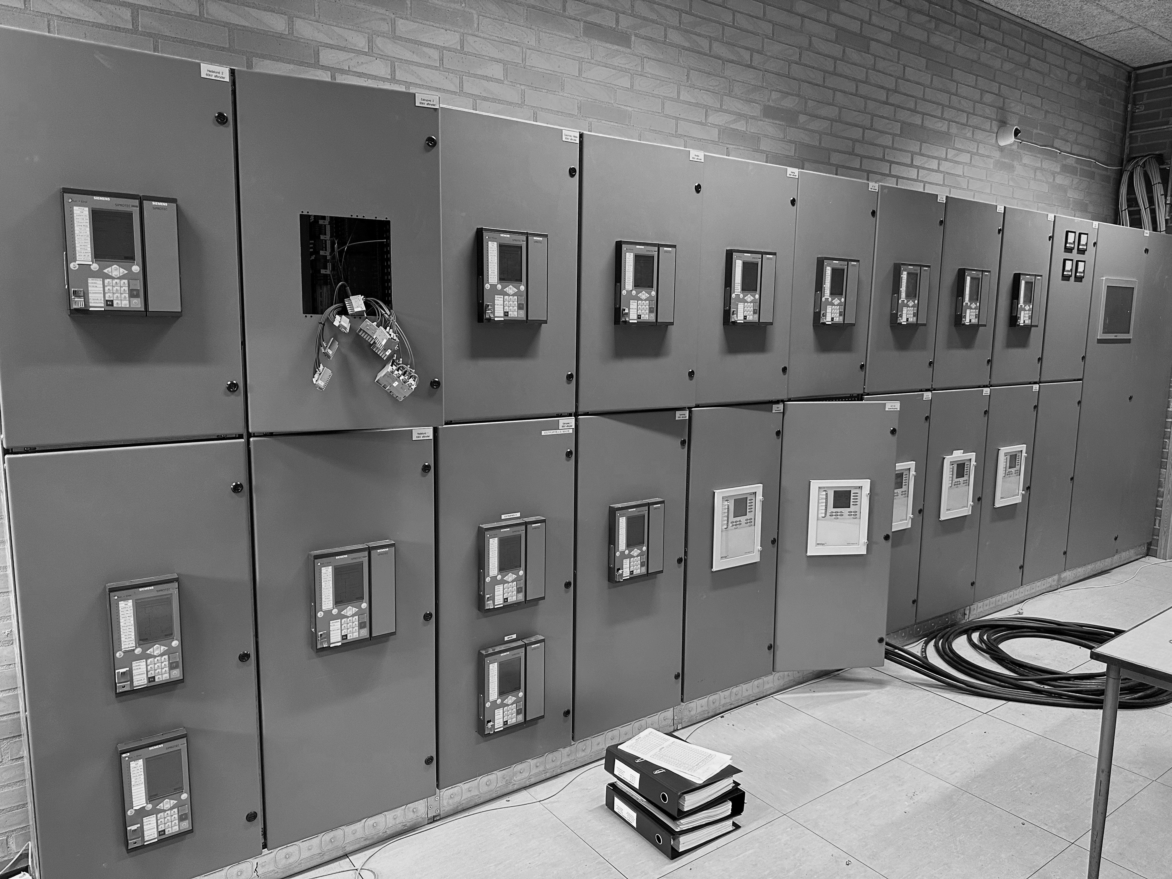
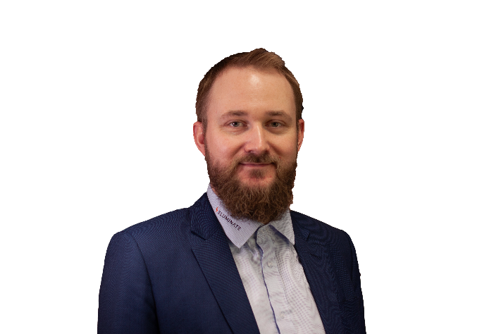
About Eluminate
In Eluminate we are specialists in grid connections, defined as the interface between the power grid and consumers/producers of energy. Eluminate offers consultancy services within the power grid industry, for low-, medium- and high-voltage grids as well as wind & solar farms and industrial customers.
Eluminate was founded in 2021 and has since worked to gather highly qualified resources in the electricity supply industry to offer a wide range of expertise. Our core values are sustainability, community, efficiency, quality and transparency.
Control and protection systems incl. OT security
Control and protection systems serve the crucial functions of safeguarding high-voltage systems and serving as a gateway for remote control from the control room and ensuring robust operation.
Eluminate possesses extensive expertise in developing, specifying and implementing fully digital control and protection concepts. Additionally, Eluminate offers consultancy services in Operational Technology (OT) security within the power grid. This includes guiding organizations through the process of conducting risk assessments, mandated by the European NIS-2 directive effective from October 2024.
Eluminate works agile!
Agile revolves around collaboration, adaptability, and a commitment to deliver value incrementally. It's an ongoing, iterative process that prioritizes customer satisfaction, team collaboration, and continuous improvement.
We collaborate closely between team members and with our customers to define project goals, and iteratively develop and adapt based on feedback, ensuring transparency in our progress.
Regular showcases and client involvement are key, fostering flexibility to accommodate changing requirements.
We prioritize open communication and continuous improvement for successful project outcomes.
Eluminate works in a sense as an umbrella organization, as we are committed to and prioritize community, bringing together the best team members towards a common goal.
Grid Connection
Grid connections involve linking electrical energy producers and consumers to the electricity grid, requiring system design and implementation for seamless distribution. Eluminate assists energy producers and grid companies by managing processes for connecting installations in low, medium, and high voltage grids, offering guidance on charging infrastructure. Services encompass preparing specifications and tender documents for low, medium, and high voltage installations, as well as dimensioning electrical setups in these ranges.
Power Quality
Eluminate are experts in power quality. There are several parameters that can affect voltage quality and cause malfunction or damage to electrical systems and components. Eluminate can measure power quality either with mobile or fixed equipment, design measuring circuits and networks for data collection, collect and structure measurement data for reporting, analyze measurement data and propose measures to solve any challenges.
Anders Dahl Johnsen
.
Partner, CCO & Lead Consultant
Smedeholm 13C
2730 Herlev, Denmark
+45 21 55 11 71
anders.johnsen@eluminate.dk
www.eluminate.dk

Slide 2
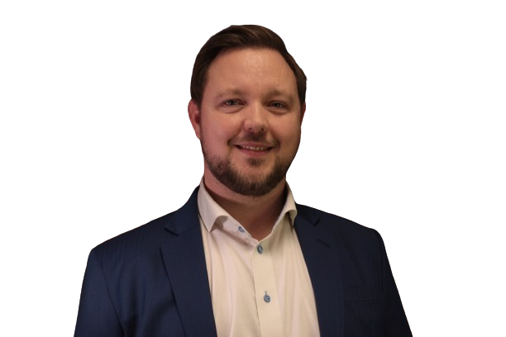
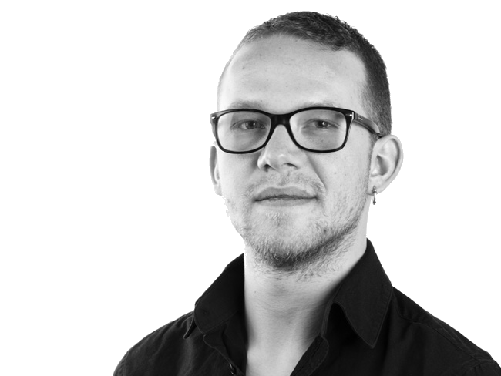
Contact
Kim Lund Sørensen
.
CEO & Lead Grid Design Manager
Smedeholm 13C
2730 Herlev, Denmark
+45 42 43 21 42
kim.soerensen@eluminate.dk
www.eluminate.dk
Anders Dahl Johnsen
.
Partner, CCO & Lead Consultant
Smedeholm 13C
2730 Herlev, Denmark
+45 21 55 11 71
anders.johnsen@eluminate.dk
www.eluminate.dk
Mikkel Svane Jensen
.
Senior Consultant
Smedeholm 13C
2730 Herlev, Denmark
+45 91 89 60 01
mikkel.jensen@eluminate.dk
www.eluminate.dk

Slide 3
Control and protection systems incl. OT Security
About Eluminate
In Eluminate we are specialists in grid connections, defined as the interface between the power grid and consumers/producers of energy. Eluminate offers consultancy services within the power grid industry, for low-, medium- and high-voltage grids as well as wind & solar farms and industrial customers.
Eluminate was founded in 2021 and has since worked to gather highly qualified resources in the electricity supply industry to offer a wide range of expertise. Our core values are sustainability, community, efficiency, quality and transparency.
Our Services
Control and protection systems for substations both onshore substations and offshore wind farms are currently being built fully digital. They will solve the core task of protecting the high-voltage systems and act as a gateway for the control room's remote control and ensuring robust operation.
Eluminate possesses extensive expertise in developing, specifying and implementing fully digital control and protection concepts. Additionally, Eluminate offers consultancy services in Operational Technology (OT) security within the power grid. This includes guiding organizations through the process of conducting risk assessments, mandated by the European NIS-2 directive effective from October 2024.
  Design, engineering & testing of control and protection systems for power grids
  Training of your employees, both the brand new and the experienced
  Training in IEC 61850 and correct use of data model as well as the possibilities of the standard
  Facilitation of concept updating through workshops, so that your current standards for design, design and preparation of the systems are brought up-to-date and support OT security
  Preparation of specifications and tender documents
  Preparation, development and implementation of the concepts for you, including development of standard templates for RTUs, SCADA and protection relays
  Preparation, development and implementation of OT safety concepts, for both existing and new plants
  Project management
  Standardization of interfaces to the high-voltage system, building, etc.
  Training and education on the job, where we are on the sidelines together with your employees and continuously train them
CASE STUDY
In 2023 we have started helping a Danish DSO getting ready for the increased expansion of their power grid needed to connect the new renewable energy production and industry customers, e.g. Power to X plants.
Eluminates responsibility is to facilitate the learning process about digital protection technologies and how IEC 61850 can support efficient engineering e.g. be leveraging top-down engineering.
This enables the lead engineers to focus on developing concept, modules, templates and processes which enables the junior engineers and external contractors to work efficiently in the projects with low risk to quality and time.
The customer has realized that when experts are hard to find & retain and more projects needs to be delivered each year, it is crucial to separate the development of concept and modules from the project-specific work. This reduces the critical path in the project time schedule and reduces the risk introduced by individual copy/paste engineering from last project and hand-crafted changes during the project.
Separation of module and concept development from project-specific work ensures a robust organization and reduces risk in projects
Well-engineered modules with clear interfaces that are tested during template development reduces the need for engineering, testing and re-engineering in each project – thus saving time in each project
Software-focused engineering reduces the hardware installation in the substations thus reducing cost
Anders Dahl Johnsen
.
Partner, CCO & Lead Consultant
Smedeholm 13C
2730 Herlev, Denmark
+45 21 55 11 71
anders.johnsen@eluminate.dk
www.eluminate.dk

Slide 4
Til Elnetselskabet N1 – intern brug
Om Eluminate
I Eluminate er vi specialister i nettilslutninger, defineret som grænsefladen mellem elnettet, og producenter samt forbrugere af energi. Eluminate tilbyder konsulentbistand indenfor lav- mellem- og højspændingsnet til netselskaber, sol- og vindpark udviklere og industrien.
Eluminate blev grundlagt i 2021 og har siden samlet højt kvalificeret personale som ingeniører og projektledere som hjælper med at accelerere den grønne omstilling af energiforsyningen.
Vores kerneværdier er bæredygtighed, netværk, effektivitet, kvalitet og transparens.
Kontrol- og beskyttelse + OT sikkerhed
Kontrol- og beskyttelsessystemer til mellem- og højspændingsnettet er en kernekompetence for os. Udover at deltage i projekter med at designe, bygge og teste disse systemer, så kan vi også hjælpe med digitalisering og effektivisering af hele processen fra specifikation og udbud til projektoverdragelse til drift.
Vi kan hjælpe jer med at modularisere og industrialisere jeres processer og koncepter, så jeres eksperter kan fokusere på at udvikle de tekniske koncepter og enkelte moduler til dem, så jeres mindre erfarne kolleger og evt. eksterne ressourcer kan arbejde effektivt i projekterne og levere høj kvalitet uden at skulle være ekspert med 10 års erfaring.
OT (Cyber) sikkerhed skal altid tænkes ind fra starten for ikke at udgøre en risiko for systemet og samfundet som helhed efter idriftsættelse. Dette har vi stor erfaring med og kan hjælpe jer med både risikoanalyser, prioritering og implementering.
Reference – Kontrol- og beskyttelse hos N1
I 2023 hjalp vi jer i Elnetselskabet N1 med analyse af beskyttelseskonceptet for 60 kV shunt spoler. Opgaven gik ud på at undersøge hvordan 60 kV afbryderne bliver påvirket af de store reaktive strømme og transiente overspændinger når der ud- og indkobles store spoler, samt hvordan beskyttelsessystemet og højspændingsanlægget kunne designes for at undgå risiko for beskadigelse af anlægget. Vi udførte simuleringer af de transiente forløb og udpegede de kritiske komponenter i systemet. Endvidere blev der afleveret en rapport med anbefalinger til design af beskyttelsessystemet.
I 2023 startede vi på to forløb, hvor vi hjælper med at strukturere arbejdet med kontrol og beskyttelsesprojekter på en måde, så jeres eksperter designer processen og modulerne med input fra os og disse moduler efterfølgende bruges i projekterne. Dette vil rykke en betydelig del af arbejdet fra at være noget der udføres i hvert projekt til at være noget der udføres som en del af konceptudviklingen. Dette vil reducere tidsforbruget og risikoen i projekterne og gøre det muligt at bruge mindre specialiserede ressourcer i projekterne, så de få eksperter ikke længere bliver overbelastede med projekter.
Dette vil gøre jer i stand til at nå jeres mål om de mange udvidelser af 60 kV stationerne for 2024.
Projektledelse
Vi kan tilbyde teknisk kyndig projektledelse, både som en del af de andre leverancer samt som selvstændig ydelse. Vi har erfaring med både SCRUM og Agile samt konventionelle metoder.
Asset Management
Vi kan hjælpe jer med at tænkte asset management ind i designet af transformer-stationer, så I får den bedste mulighed for at sikre en stabil og effekt drift af elnettet. Vi kan hjælpe med at integrere de enheder der i forvejen findes i transformerstationerne, samt bruge små sensorer som fx udnytter IoT teknologien.
Anders Dahl Johnsen
.
Partner, CCO & Lead Consultant
Smedeholm 13C, 2730 Herlev
+45 21 55 11 71
anders.johnsen@eluminate.dk
www.eluminate.dk

Slide 5
Grid Connection
About Eluminate
In Eluminate we are specialists in grid connections, defined as the interface between the power grid and consumers/producers of energy. Eluminate offers consultancy services within the power grid industry, for low-, medium- and high-voltage grids as well as wind & solar farms and industrial customers.
Eluminate was founded in 2021 and has since worked to gather highly qualified resources in the electricity supply industry to offer a wide range of expertise. Our core values are sustainability, community, efficiency, quality and transparency.
Our Services
Grid connections involve linking electrical energy producers and consumers to the public power grid. Eluminate assists energy producers, consumers and grid companies by managing processes of connecting installations in low, medium, and high voltage grids.
The services include the whole process from initial planning to specification, tendering, design, engineering, testing, commissioning and operation. In the process of grid connections on low, medium and high voltage grids, Eluminate can assist with the following parts:
Charging infrastructure for cars, trucks, busses, trains.
Electrical installations and primary equipment: Switchboards, switchgear, measuring transformers, power transformers, power factor compensation
Cable design and specification
Preparation of requirements, specifications and tender documents + review of offers
Consulting of asset owners and commissioning supervision
Training in design, operation and maintenance of electrical plant and installations as well as switchboards and electrical equipment on machines
Calculation and design of the switchboards and selection of appropriate safety clothing for working with the switchboards under voltage
Control and protection systems
OT (Cyber) Security
Power quality simulations, measurements, analysis and recommendations
Asset monitoring and lifecycle management
For the above mentioned services we are experiences in both consulting, designing, engineering, testing, validating and operating the systems.
CASE STUDY – Offshore wind farm
In 2023, Eluminate have participated in an offshore Wind project supporting the grid connection team. Eluminate’s contributed with essential knowledge on:
Analysis of harmonics
Design of measuring circuits for array cables
...
TO BE UPDATED WITH RELEVANT CASE
Kim Lund Sørensen
.
CEO & Lead Grid Design Manager
Smedeholm 13C
2730 Herlev, Denmark
+45 42 43 21 42
kim.soerensen@eluminate.dk
www.eluminate.dk

Slide 6
Power Quality
About Eluminate
In Eluminate we are specialists in grid connections, defined as the interface between the power grid and consumers/producers of energy. Eluminate offers consultancy services within the power grid industry, for low-, medium- and high-voltage grids as well as wind & solar farms and industrial customers.
Eluminate was founded in 2021 and has since worked to gather highly qualified resources in the electricity supply industry to offer a wide range of expertise. Our core values are sustainability, community, efficiency, quality and transparency.
Our Services
Eluminate are experts in power quality. There are several parameters that can affect the power quality and cause malfunction or damage to electrical systems and components. Eluminate can measure power quality either with mobile or fixed equipment, design measuring circuits and networks for data collection, collect and structure measurement data for reporting, analyze measurement data and propose measures to solve any challenges.
Eluminate offers the following services within Power quality:
Installation of measuring equipment on low-, medium- and high-voltage installations
Analysis of measurement data and documentation of power quality
Preparation of measurement reports as a basis for dialogue regarding remediation of power quality problems
Advice within solutions to documented power quality problems
Advice and design of new plants taking power quality into account
Teaching and workshops regarding power quality
Certification of existing as well as new plants
Rental of measuring equipment
Be aware that many companies offer power quality consultancy but only very few understand the topic in depth and can design a measuring circuit that allows the high frequency voltages and currents to reach the measuring equipment.
CASE STUDY
A client's industrial plant was fitted with backup generators and Uninterruptible Power Supply systems (UPS) to ensure stable operation in case of a grid supply fault.
After a few months of operation, some UPS´s broke down and Eluminate was asked to identify the problem.
The UPS systems were disconnected to prevent further damage, and power quality measurements were taken at the affected busbars to determine the root cause of the problem. Eliminates analysis concluded that while the electricity coming from the grid was being properly filtered, the filters weren’t protected from harmonic distortions coming from the load side.
The motors of the facility and other equipment on site were creating harmonic distortion in the current, with no preventive measures in place.
Having reached a conclusion on the cause of the issue, the client was informed, and suggestions were made on what solutions must be implemented before the UPS could be connected again.
Implementing this solution, the client will benefit from:
Prevention of further breakdowns of expensive electrical components and disruption of production
Reconnection of the UPS, guaranteeing no interruptions of supply, which may prove costly and affect production
Improved power quality – increasing the lifetime of electrical components and overall energy efficiency
Kim Lund Sørensen
.
CEO & Lead Grid Design Manager
Smedeholm 13C
2730 Herlev, Denmark
+45 42 43 21 42
kim.soerensen@eluminate.dk
www.eluminate.dk

Slide 7
Power Quality
About Eluminate
In Eluminate we are specialists in grid connections, defined as the interface between the power grid and consumers/producers of energy. Eluminate offers consultancy services within the power grid industry, for low-, medium- and high-voltage grids as well as wind & solar farms and industrial customers.
Eluminate was founded in 2021 and has since worked to gather highly qualified resources in the electricity supply industry to offer a wide range of expertise. Our core values are sustainability, community, efficiency, quality and transparency.
Our Services
Eluminate are experts in power quality. There are several parameters that can affect the power quality and cause malfunction or damage to electrical systems and components. Eluminate can measure power quality either with mobile or fixed equipment, design measuring circuits and networks for data collection, collect and structure measurement data for reporting, analyze measurement data and propose measures to solve any challenges.
Eluminate offers the following services within Power quality:
Installation of measuring equipment on low-, medium- and high-voltage installations
Analysis of measurement data and documentation of power quality
Preparation of measurement reports as a basis for dialogue regarding remediation of power quality problems
Advice within solutions to documented power quality problems
Advice and design of new plants taking power quality into account
Teaching and workshops regarding power quality
Certification of existing as well as new plants
Rental of measuring equipment
Be aware that many companies offer power quality consultancy but only very few understand the topic in depth and can design a measuring circuit that allows the high frequency voltages and currents to reach the measuring equipment.
CASE STUDY
A client's industrial plant was fitted with backup generators and Uninterruptible Power Supply systems (UPS) to ensure stable operation in case of a grid supply fault.
After a few months of operation, some UPS´s broke down and Eluminate was asked to identify the problem.
The UPS systems were disconnected to prevent further damage, and power quality measurements were taken at the affected busbars to determine the root cause of the problem. Eliminates analysis concluded that while the electricity coming from the grid was being properly filtered, the filters weren’t protected from harmonic distortions coming from the load side.
The motors of the facility and other equipment on site were creating harmonic distortion in the current, with no preventive measures in place.
Having reached a conclusion on the cause of the issue, the client was informed, and suggestions were made on what solutions must be implemented before the UPS could be connected again.
Implementing this solution, the client will benefit from:
Prevention of further breakdowns of expensive electrical components and disruption of production
Reconnection of the UPS, guaranteeing no interruptions of supply, which may prove costly and affect production
Improved power quality – increasing the lifetime of electrical components and overall energy efficiency
Anders Dahl Johnsen
Kim Lund Sørensen
.
.
Partner, CCO & Lead Consultant
Smedeholm 13C
2730 Herlev, Denmark
+45 21 55 11 71
anders.johnsen@eluminate.dk
www.eluminate.dk
CEO & Lead Grid Design Manager
Smedeholm 13C
2730 Herlev, Denmark
+45 42 43 21 42
kim.soerensen@eluminate.dk
www.eluminate.dk

Slide 8
Novo Nordisk – For internal use
About Eluminate
In Eluminate we are specialists in grid connections, defined as the interface between the power grid and consumers/producers of energy. Eluminate offers consultancy services within the power supply industry, for low-, medium- and high-voltage grids as well as wind & solar farms and industrial customers.
Eluminate was founded in 2021 and has since worked to gather highly qualified resources in the electricity supply industry to offer a wide range of expertise. Our core values are sustainability, community, efficiency, quality and transparency.
Our Services
Eluminate are experts in power quality. There are several parameters that can affect the power quality and cause malfunction or damage to electrical systems and components. Eluminate can measure power quality either with mobile or fixed equipment, design measuring circuits and networks for data collection, collect and structure measurement data for reporting, analyze measurement data and propose measures to solve any challenges.
Eluminate offers the following services within Power quality:
Installation of measuring equipment on low-, medium- and high-voltage installations
Analysis of measurement data and documentation of power quality
Preparation of measurement reports as a basis for dialogue regarding remediation of power quality problems
Advice within solutions to documented power quality problems
Advice and design of new plants taking power quality into account
Teaching and workshops regarding power quality
Certification of existing as well as new plants
Rental of measuring equipment
Be aware that many companies offer power quality consultancy but only very few understand the topic in depth and can design a measuring circuit that allows the high frequency voltages and currents to reach the measuring equipment.
CASE STUDY
In 2023, Novo Nordisk plant in Hillerød was started up for the first time with 3 new Uninterruptible Power Supply systems (UPS), to guarantee stable operation in case of a grid supply fault. The UPS’s were implemented between the grid and the loads in building 25K, with a filter placed at each output to improve the power quality at the load side.
After a few months of operation, two UPS´s broke down, Eluminate was asked to identify the problem by Jon Bjerring, associate manager - facility support.
The UPS systems were disconnected to prevent further damage, and power quality measurements were taken at the affected busbars to determine the root cause of the problem. Eliminates analysis concluded that while the electricity coming from the grid was being properly filtered, the filters weren’t protected from harmonic distortions coming from the load side. The power electronic switching devices driving the motors were creating harmonic distortion in the current, with no preventive measures in place. Having reached a conclusion on the cause of the issue, Novo Nordisk was informed, and suggestions were made on what solutions must be implemented before the UPS could be connected again.
Implementing this solution, Novo Nordisk will benefit from:
Prevention of further breakdowns of expensive electrical components
Reconnection of the UPS, guaranteeing no interruptions of supply, which may prove costly and affect production
Improved power quality – increasing the lifetime of electrical components and overall energy efficiency
Kim Lund Sørensen
.
CEO & Lead Grid Design Manager
Smedeholm 13C
2730 Herlev, Denmark
+45 42 43 21 42
kim.soerensen@eluminate.dk
www.eluminate.dk

